Slide 1
Infineon product Mind Map and Selection Tool
Vasily Basov
26.07.2018

Slide 2
Index
What is the tool?
How to run XMind?
3 steps to start
How to use the tool

Slide 3
What is the Infineon product mind mapping tool?
The tool is a mind map which reflects structure and hierarchy of Infineon portfolio. The mind map is created in popular mind mapping software called XMind.
XMind is very popular mind-mapping software. It has many different graphical possibilities for displaying mind maps. For example it has so called “matrix” view which is a hybrid between table and mind map tree. We found that this view is very convenient for fast product selection.
XMind allows to put internet links and attach files to the topics. User can open attached files or follow links to datasheets in one click.
Classical mind mapping is a manual work. Creating mind maps is useful thinking and studying exercise helping us to understand, cross-link and memorize big volume of data or complex ideas.
Infineon portfolio of >10.000 parts is a huge piece of data for human mind. Luckily it has defined structure and can be presented as multi-level selection tree or mind map.
The problem: This is very large mind map and we can’t draw it manually. Even if we did, every change of the portfolio would require manual work to update. On top of that, the mind map can be build in multiple ways from the same data depends on parameters order. The convenient mind map format depends on customer’s application. For instance in some application of MOSFETs we need V_{ds} and R_{ds(on)} to choose the right part. In another situation we can choose based on V_{ds} , I_{ds(on)} and package. So, ideally we need many parallel mind maps which show the portfolio from different viewpoints.
Fortunately we don’t need to created this mind maps manually. We made software which takes the data from the official Infineon website, processes it and build various versions of mind maps in a fraction of second. I can build new view and update existing with new data very quick and without manual work.
The tool is provided to users as internet link to zip archive with XMIND files. The archive is constantly updated with new data. So it’s recommended that the user download it again every week.
Learn more about XMind on www.xmind.net . The XMind has free version and more professional paid version. The free version has all the functions needed in our tool. Make sure you have XMind 8 or later version. The tool won’t work properly on “XMind ZEN” software which is also available from the www.xmind.net website. See download link and installation options in “How to run Xmind” section of this presentation.

Slide 4
How to run XMind?
The Mind Map and the selection tool needs XMIND software on your computer to run. This is free software (in basic version). The functionality of the free version is enough for us.
There are two options to get it:
Option 1: Download and install free XMIND version from website. The installation procedure may request access rights to install the software. Enabling local admin via iARM during the installation is needed on Infineon’s systems. Go to https://www.xmind.net/download/win/ and click on “Download XMind for Windows (exe)”
Option 2: Download all-in-one XMind package which allows to use XMind without installation. Go to https://www.xmind.net/download/win/ and click “Download XMind for Windows (zip)”. After downloading unzip to folder in convenient location (e.g. Desktop) and run by double clicking on Xmind.exe

Slide 5
3 steps to start
Make sure that you have XMind software on your computer. No difference if it’s complete installation or all-in-one XMind package which works without installation. See instruction on the previous page.
Download fresh data from https://github.com/vbasov007/IFX-Product-MAP/archive/master.zip. Save in any folder (e.g. Desktop) and unzip
Open file START_HERE.xmind in XMind. Note: if you have XMind software completely installed on you system then the system already knows .xmind extension and you can just double click on the file to open XMind software. If you use all-in-one package then most probably .xmind extension is not associated with XMind.exe. This case you can first start XMind.exe and then open .xmind file via File menu. Also, you can associate .xmind extension with XMind.exe via dialog box which starts in Windows when you click on any file with unknown extension.

Slide 6
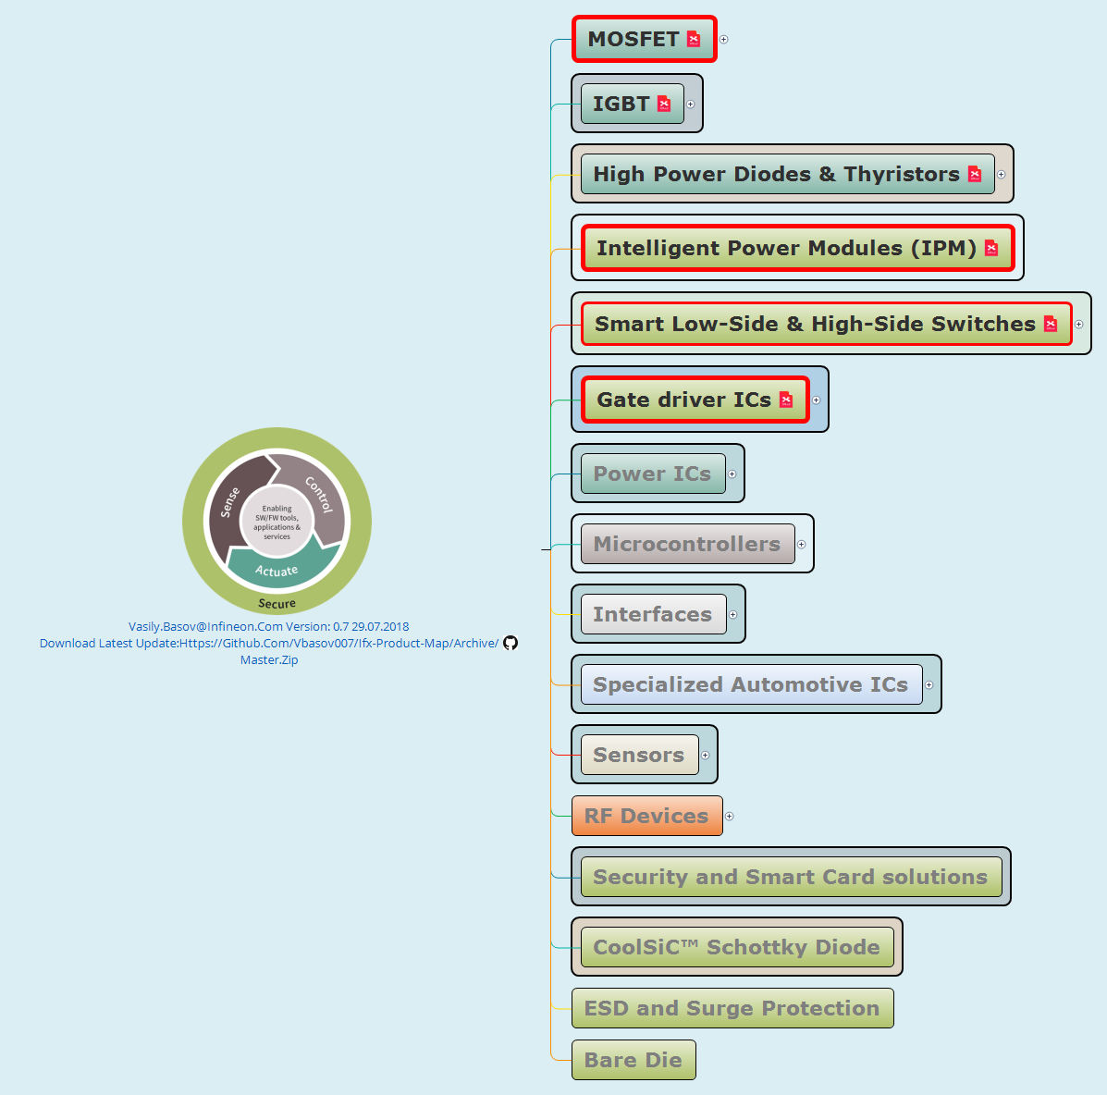
START HERE:
Those topics have something more. Now click on icon inside MOSFET topic*
* The icon appearance can be different on the system where XMind is not installed Most probably it will be “white sheet” icon which means “unknown file type” in Windows 10 Don’t worry about this. Just click it.

Slide 7
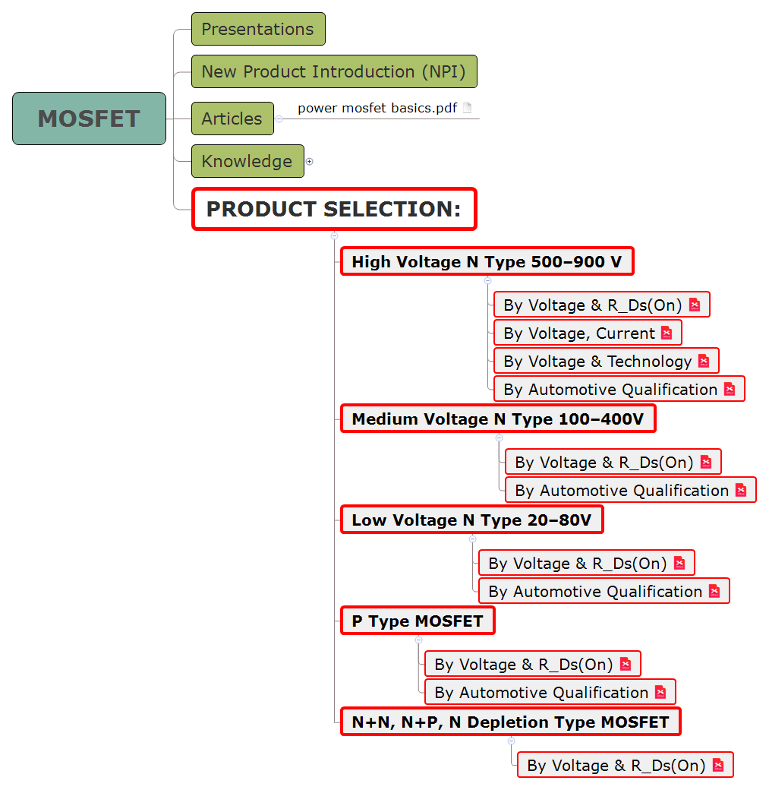
MOSFET page
Thank you for waiting this page loaded It might take few seconds until XMind has it shown. When you navigate to this page second time during the session it shows up instantly because the data already in memory.
Every topic with icon is clickable. There are different representations of MOSFET data under each topic. Click now on the first topic to see the Voltage->R_ds(on) table

Slide 8
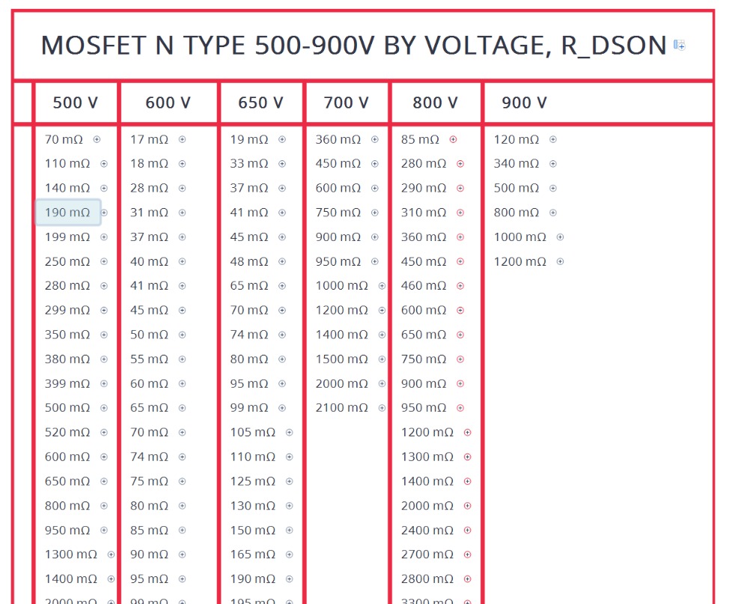
Voltage, R_ds(on) page
Expand and collapse topics by clicking on ⊕ and ⊝
There are hot keys:
“*” - expand current topic and all his subtopics,
“/” - collapse current subtopic
If you start type in a topic by mistake and just don’t want to save the changes press “Esc”. To undo any change press Ctrl-Z
Note that anything what you do with the map (e.g. expanding some topics) changes the file and XMIND want to save the changes. It will ask if you try to close the file. Just close without saving if you don’t need this changes
Look to the next slide as example what you can see

Slide 9
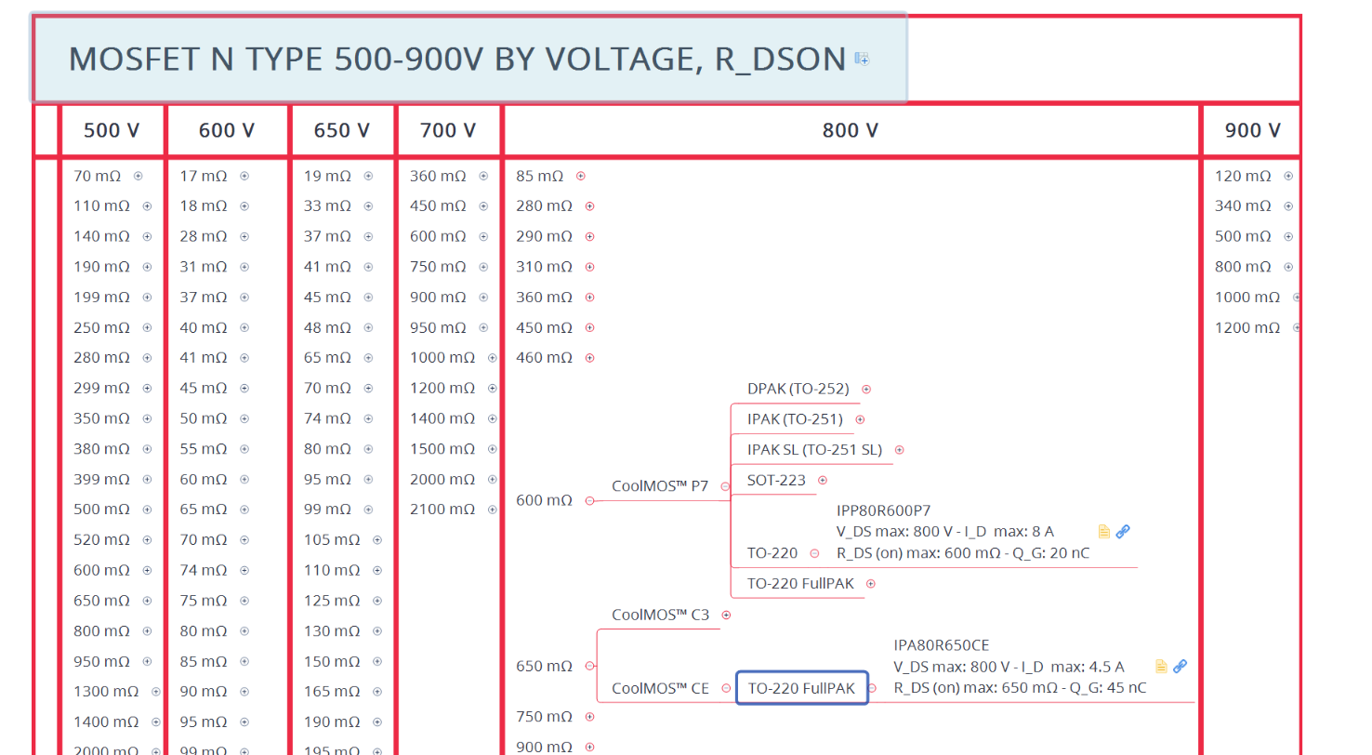

Slide 10
Thank you!
Send your feedback and ideas to
Vasily.Basov@Infineon.com
Don’t forget to get the latest version of the mind map:
https://github.com/vbasov007/IFX-Product-MAP/archive/master.zip

